Slide 1
Pre/Post Processes for GWLF
Ruitang Sung
June-21 & June-28, 2012

Slide 2
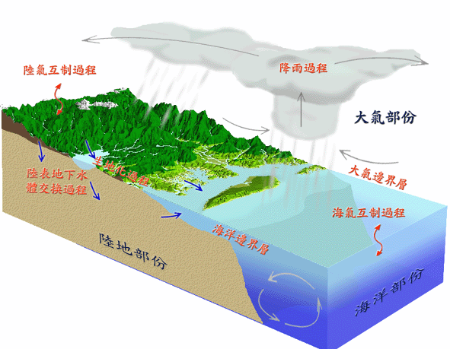
Simplify the Real World into the Conceptual Hydrological Model
Real World
Hydrological Model

Slide 3
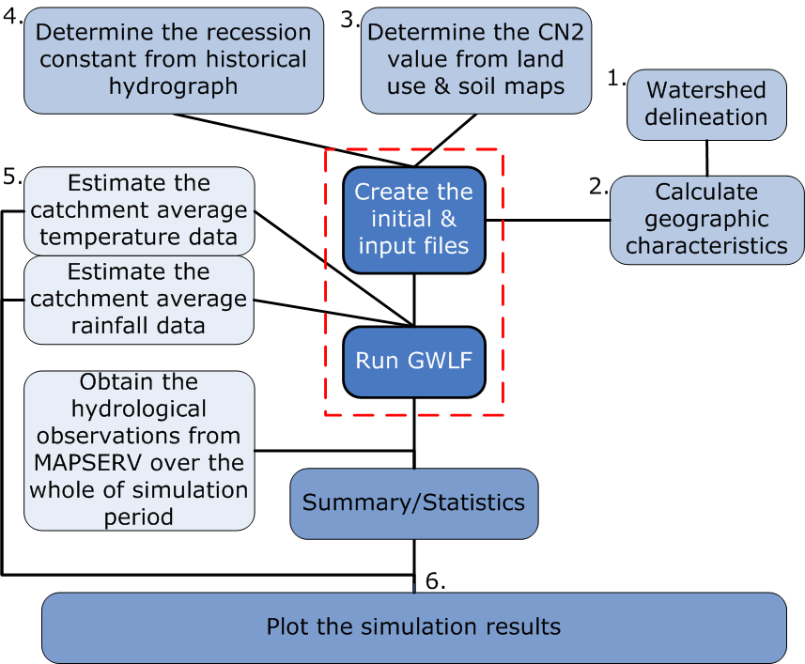
Outline
Decision Marking*

Slide 4
Delineate Watershed Using Arc Hydro
Arc Hydro is a geospatial & temporal data model for water resources that operates with ArcGIS.
Arc Hydro has an associated set of tools, that populate the attributes of the features in the data framework, interconnect features in different data layers, & support hydrological analysis.
Fill sinks
Flow Direction
Flow Accumulation
Stream Networks*
Watershed Delineation (Arc Toolbox)

Slide 5
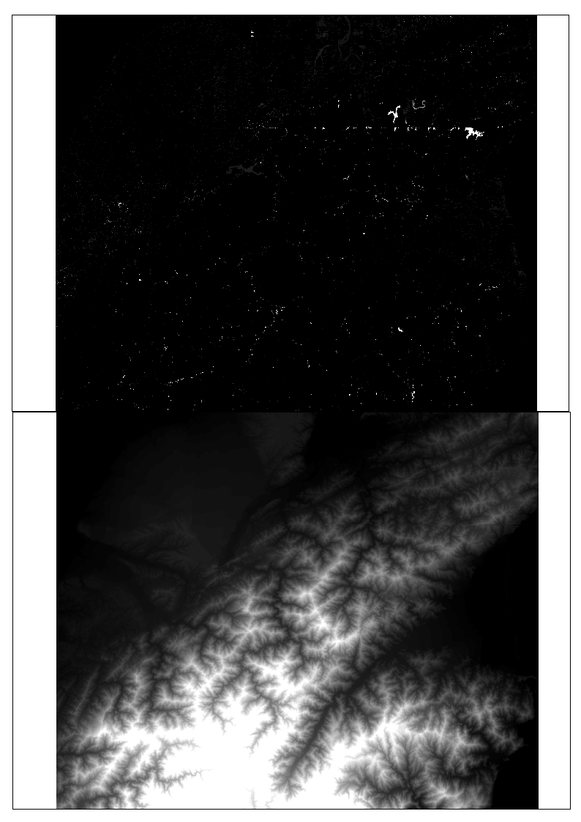
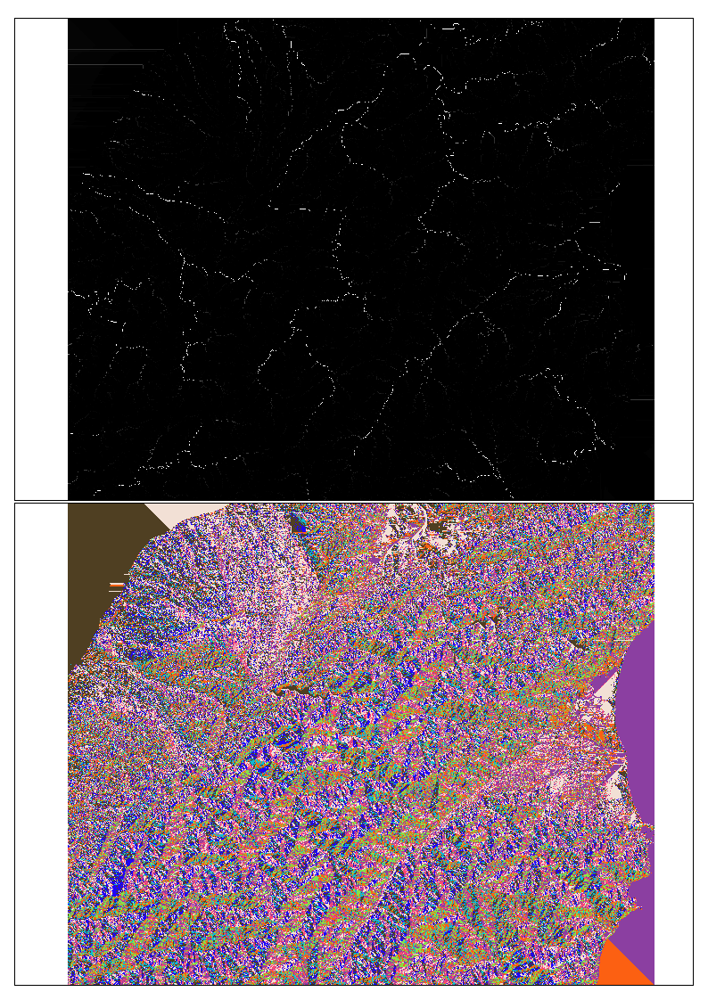
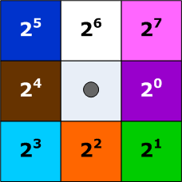
Delineate Watershed Using Arc Hydro (cont.)
Flow accumulation
Elevation difference between before and after the fill sinks
Stream network
DTM/DEM
Flow
direction

Slide 6
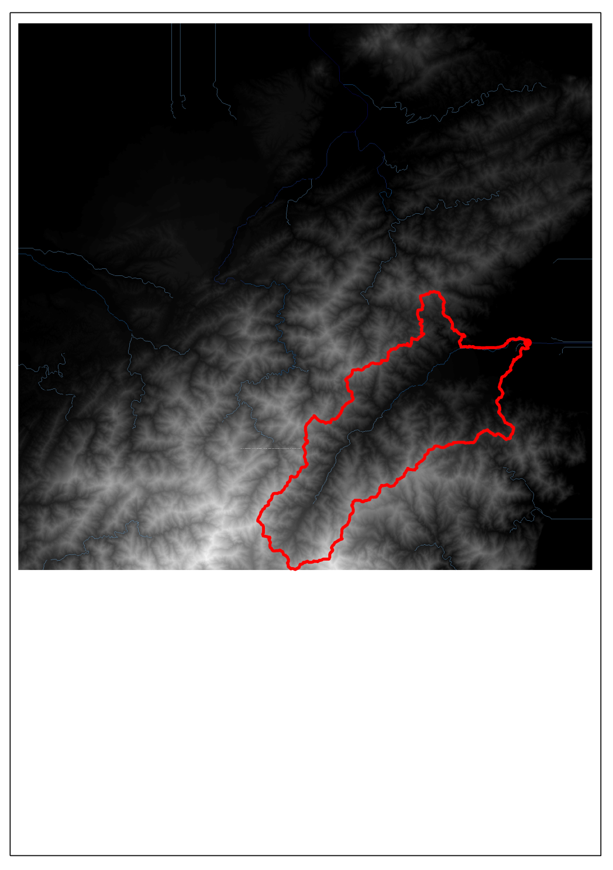
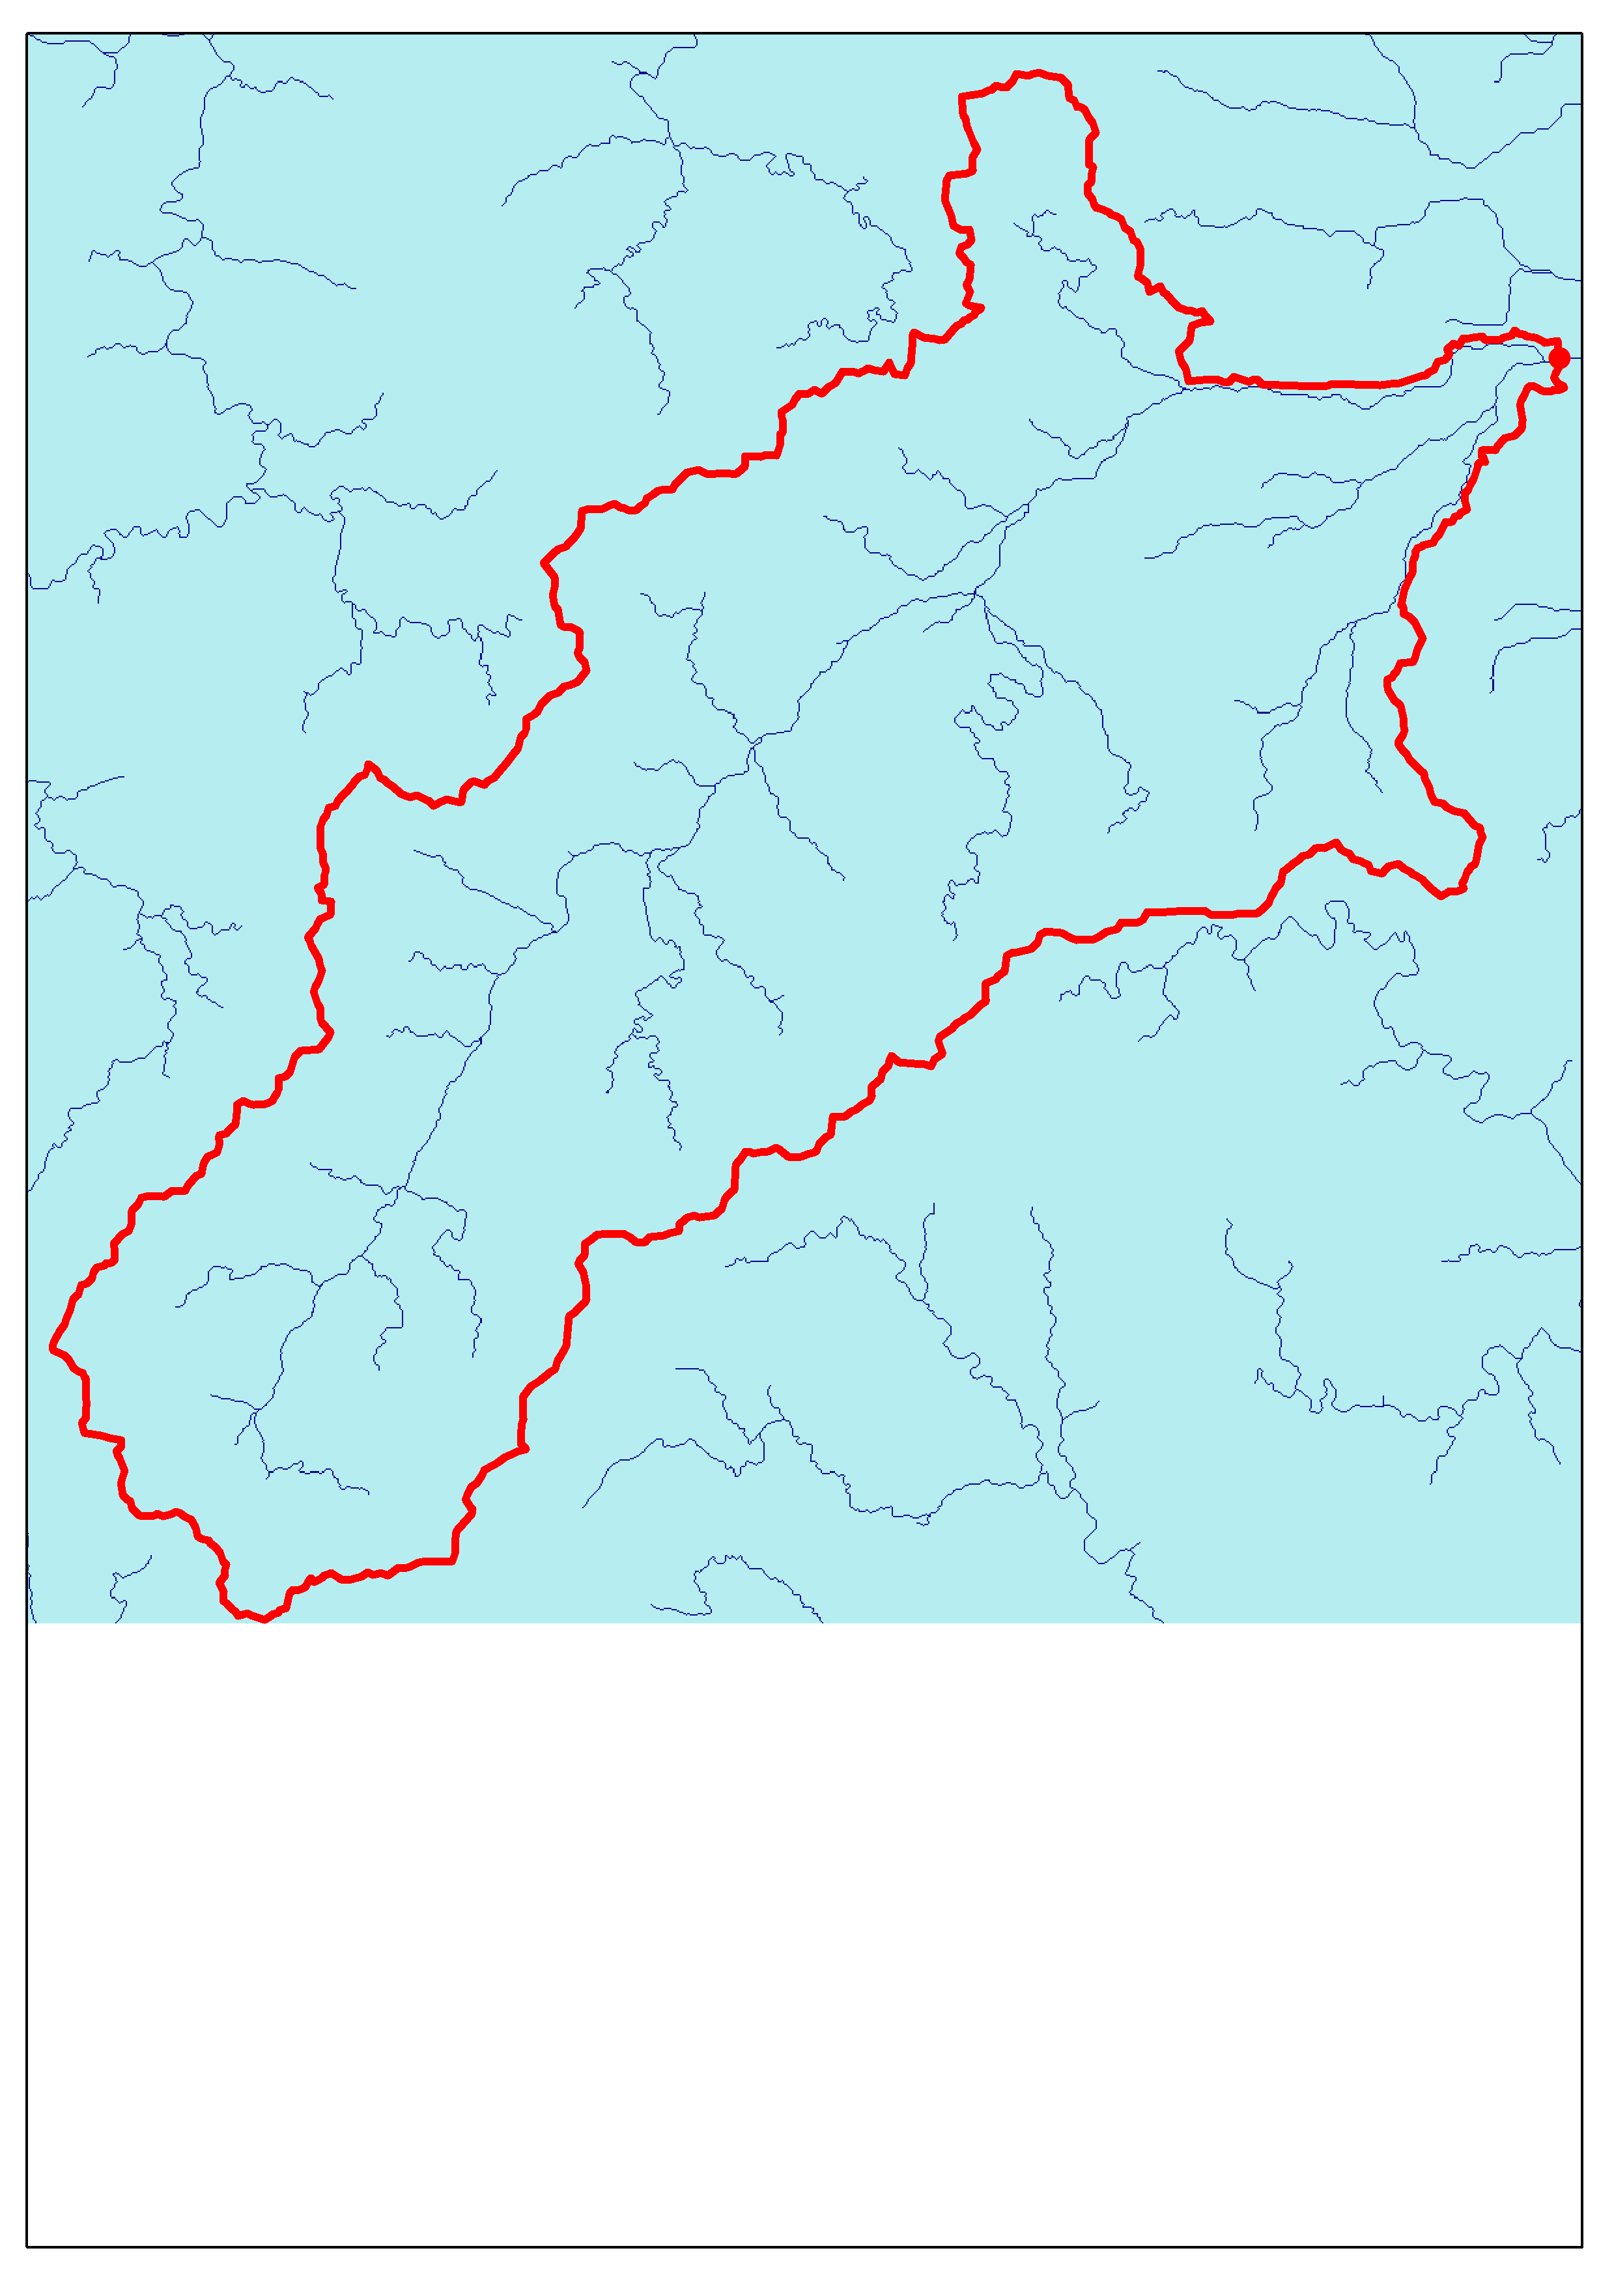
Delineate Watershed Using Arc Hydro (cont.)

Slide 7
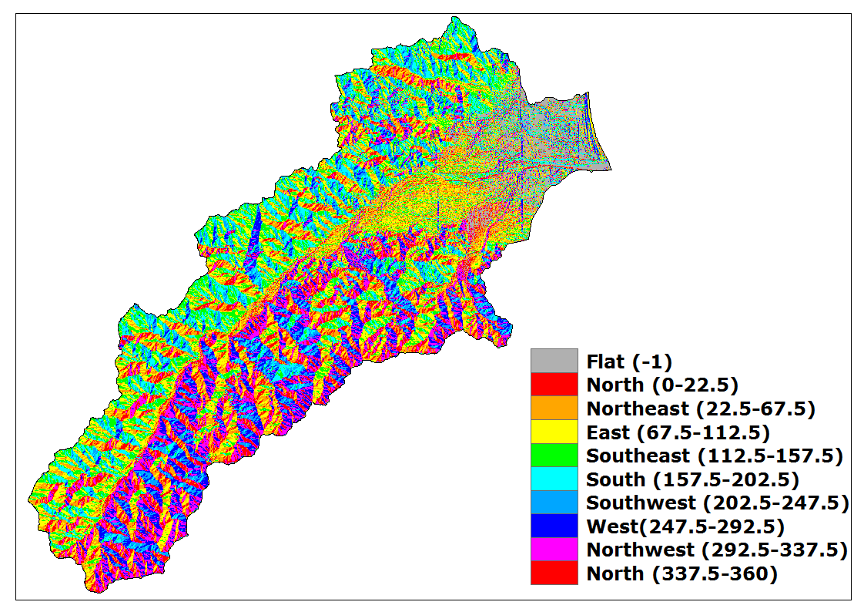
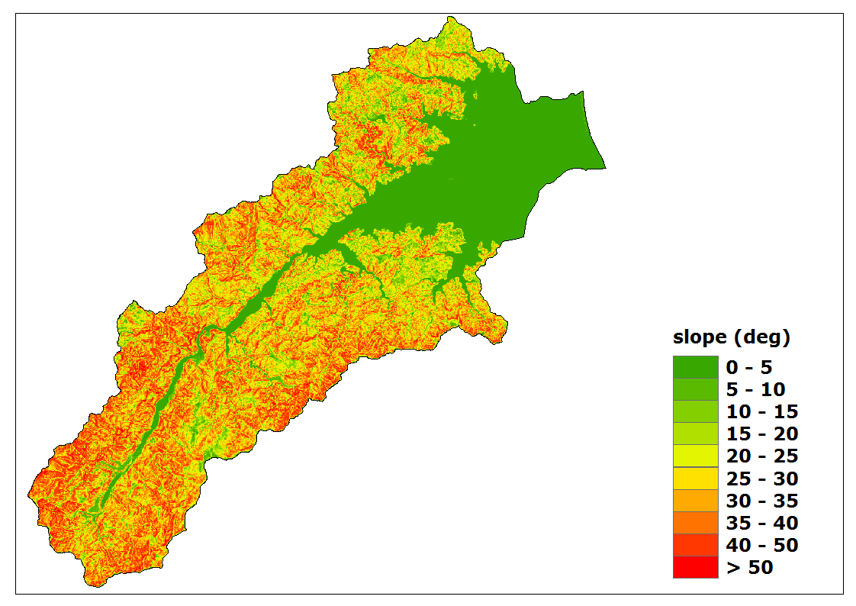
Calculate Geographic Characteristics
Catchment Area: 813.56 km² (820.69 km²)
Centroid: 303730.27, 2719518.02
Basin Average Elevation: 939.08 m
Mean Slope: 25.41°
Mountain/Valley Orientation: Southwest-Northeast
…

Slide 8
Extract the Land Use & Land Cover (LULC)
Acquire from LULC map or digitize from Google Earth or geographic map, …
Reclassify
Water: wet land/rivers/lakes,
Forest: forest/shrub,
Agricultural land: cultivated land/orchard,
Building: urban/roads/building lot,
Grassland: pasture/rangeland,
Bare land: barren land/outcrop/quarry, …
Calculate the area & weighting for each LULC type by using ArcGIS

Slide 9
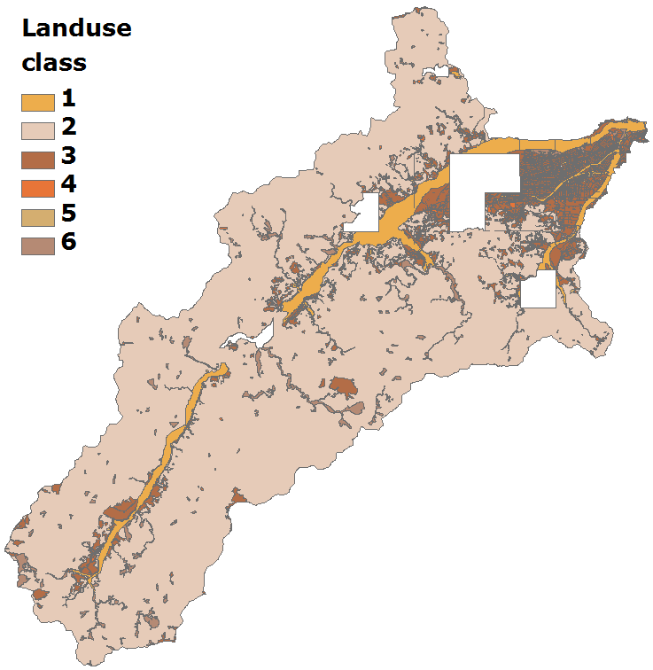
Extract the Land Use & Land Cover (cont.)
Caution: map gap
Type | Area (km²) | Weighting | CN
Water | 47.50 | 0.060 | 100
2.Forest | 644.89 | 0.816 | 55
3.Agricultural land | 67.11 | 0.085 | 75
4.Building | 8.62 | 0.011 | 98
5.Grassland | 1.59 | 0.002 | 61
6.Bare land | 20.66 | 0.026 | 79
Total | 790.38 | 1.000 | 61

Slide 10
Fix the gap of the LULC Map
Convert the LULC patch to a Shapefile when invalid topology has occurred
Find out the pointset at 4 corners of the LULC patch
Create a Feature Class (Polygon) & draw a new quadrilateral
Make a union of the quadrilateral and LULC patch
Delete the exterior parts of the LULC patch
Repeat above the processes until fixed all patches with poor topology

Slide 11
Soil Conservation Service (SCS) Curve Numbers for Selected Land Use
 | Hydrologic Soil Group
 | A | B | C | D
Water | 100 | 100 | 100 | 100
Forest | 30 | 55 | 70 | 77
Agricultural land | 63 | 75 | 83 | 87
Building | 98 | 98 | 98 | 98
Grassland | 39 | 61 | 74 | 80
Bare land | 68 | 79 | 86 | 89
Group A: Deep sand, deep loess, aggregated silts
Group B: Shallow loess, sandy loam
Group C: Clay loams, shallow sandy loam, soils low in organic content, and soils usually high in clay
Group D: Soils that swell significantly when wet, heavy plastic clays, and certain saline soils

Slide 12
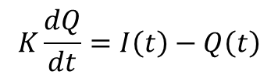
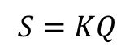
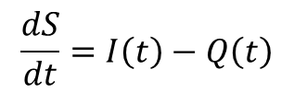
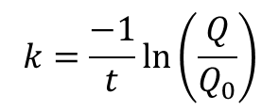
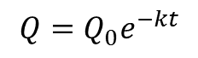
Determine the Recession Constant from Historical Hydrograph
Recall the continuity eq., as
Based on the linear reservoir model:
Thus,
Meyboom [1961] introduced a method to determine the recession constant, k or 1/K, from semi-logarithmical hydrograph
The recession constant can be expressed:
$$\frac{dS}{dt}=I\left(t\right)−Q\left(t\right)$$
$$S=KQ$$
$$K\frac{dQ}{dt}=I\left(t\right)−Q\left(t\right)$$
$$Q=Q_{0}e^{−kt}$$
$$k=\frac{−1}{t}ln\left(\frac{Q}{Q_{0}}\right)$$
From 1949 to 2009
(1)

Slide 13
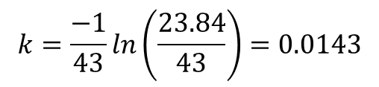
Determine the Recession Constant from Historical Hydrograph (cont.)
Q₀
Q
Offset the daily streamflow data by 1 month
Find out the parameters of Q₀ = 44 cms, Q = 23.84 cms, t = 358 – 315 = 43 days
Substitute the above parameters into Eq. (1), we have
$$k=\frac{−1}{43}ln\left(\frac{23.84}{43}\right)=0.0143$$

Slide 14
DECLARE
no NUMBER;
first NUMBER;
last NUMBER;
initial_date DATE;
days DATE;
BEGIN
no := 235;
first :=1949;
last := 2009;
initial_date := To_Date('01-01', 'mm-dd');
FOR i IN 0 .. 365 --leap year
LOOP
days := initial_date + i;
FOR cursor1 IN (SELECT To_Char(days, 'mm-dd') date_, PERCENTILE_CONT (0.50) WITHIN GROUP (ORDER BY discharge) Q_50 FROM dailydischarge WHERE station_name = no AND To_Char(rec_date, 'mm-dd') = To_Char(days, 'mm-dd') AND To_Char(rec_date,'yyyy') BETWEEN first AND last AND status = 0)
LOOP
DBMS_OUTPUT.PUT_LINE(cursor1.date_ || chr(9) || cursor1.Q_50);
END LOOP;
END LOOP;
END;

Slide 15
Obtain the Rainfall & Temperature Data from MAPSERV
SELECT * FROM stations WHERE station IN ('宜蘭','桶後','南山','留茂安','梵梵(2)','土場(1)','池端','新北城','新寮(1)') ORDER BY oid;
SELECT To_Number(To_Char(rec_date, 'yyyymmdd')) date_, precipitation*10 pp, status ss FROM dailyprecipitation WHERE station_name=26 AND To_Char(rec_date, 'yyyy') BETWEEN 1967 AND 2009 ORDER BY rec_date;
…
SELECT To_Number(To_Char(rec_date, 'yyyymmdd')) date_,
precipitation*10 pp, status ss FROM dailyprecipitation WHERE
station_name=241 AND To_Char(rec_date, 'yyyy') BETWEEN 1967
AND 2009 ORDER BY rec_date;
SELECT To_Number( To_Char(rec_date, 'yyyymmdd') ) date_, temperature temp FROM dailytemperature WHERE station_name= 105 AND To_Char(rec_date, 'yyyy') BETWEEN 1967 AND 2009 ORDER BY rec_date;

Slide 16
SELECT a.date_, a.pp, a.ss, b.pp, b.ss, c.pp, c.ss, d.pp, d.ss, e.pp, e.ss,
f.pp, f.ss, g.pp, g.ss, h.pp, h.ss, i.pp, i.ss, j.pp, j.ss
FROM
(SELECT To_Number(To_Char(rec_date, 'yyyymmdd')) date_, precipitation/10 pp, status ss FROM dailyprecipitation WHERE station_name=105 AND To_Char(rec_date, 'yyyy') BETWEEN 1967 AND 2009 ORDER BY rec_date) a,
…
(SELECT To_Number(To_Char(rec_date, 'yyyymmdd')) date_, precipitation/10 pp, status ss FROM dailyprecipitation WHERE station_name=241 AND To_Char(rec_date, 'yyyy') BETWEEN 1967 AND 2009 ORDER BY rec_date) j
WHERE
a.date_=b.date_(+) AND a.date_=c.date_(+) AND a.date_=d.date_(+) AND a.date_=e.date_(+) AND a.date_=f.date_(+) AND a.date_=g.date_(+) AND a.date_=h.date_(+) AND a.date_=i.date_(+) AND a.date_=j.date_(+) ORDER BY a.date_;

Slide 17
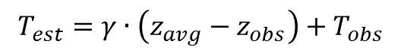
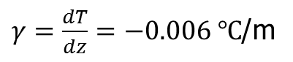
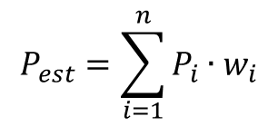
Estimate the Catchment Average Rainfall & Temperature
Catchment average rainfall were calculated using the interpolation (e.g., kriging, spline, etc.) or Thiessen polygons method.
Ex: Thiessen polygon method was defined as
Catchment average temperature were estimated using the environmental lapse rate.
Environmental lapse rate was defined as
$γ=\frac{dT}{dz}=−0.006 ℃$/m
$$P_{est}=\sum_{i=1}^{n}{P_{i}∙w_{i}}$$
So,
$$T_{est}={γ∙\left(z_{avg}−z_{obs}\right)+T}_{obs}$$

Slide 18
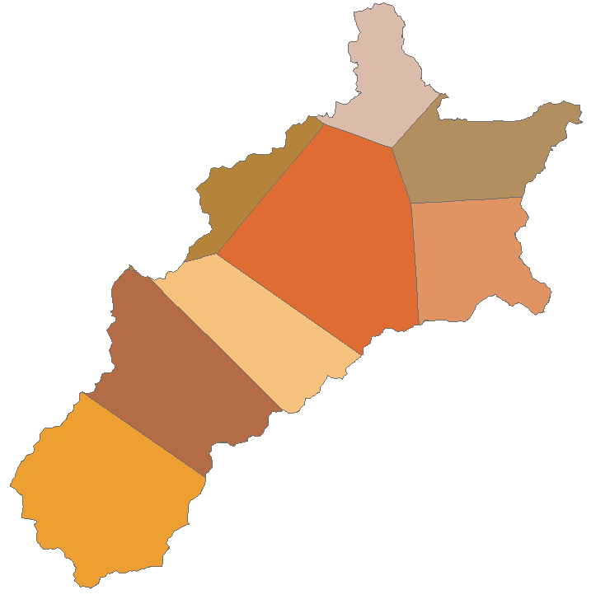
Estimate Catchment Average Rainfall Using Thiessen Polygons Method
241
OID | Station Name | Area (km²) | Weighting
105 | 宜蘭 | --- | 0.000
241 | 桶後 | 56.51 | 0.070
227 | 南山 | 144.12 | 0.177
228 | 留茂安 | 129.45 | 0.159
230 | 梵梵(2) | 184.51 | 0.227
229 | 土場(1) | 93.83 | 0.115
26 | 池端 | 39.22 | 0.048
141 | 新北城 | 82.09 | 0.101
231 | 新寮(1) | 83.81 | 0.103
 | Total: | 813.53 | 1.000
105
26
141
230
231
229
228
227

Slide 19
Visualization
Map Projections
Cartographic Generalization (製圖綜合)
Thematic Map
Label, Symbol, Legend, North Arrow, Scale Bar, Snapshot, …
Geographic Map with Shading Effect
Animation
Other Applications

Slide 20
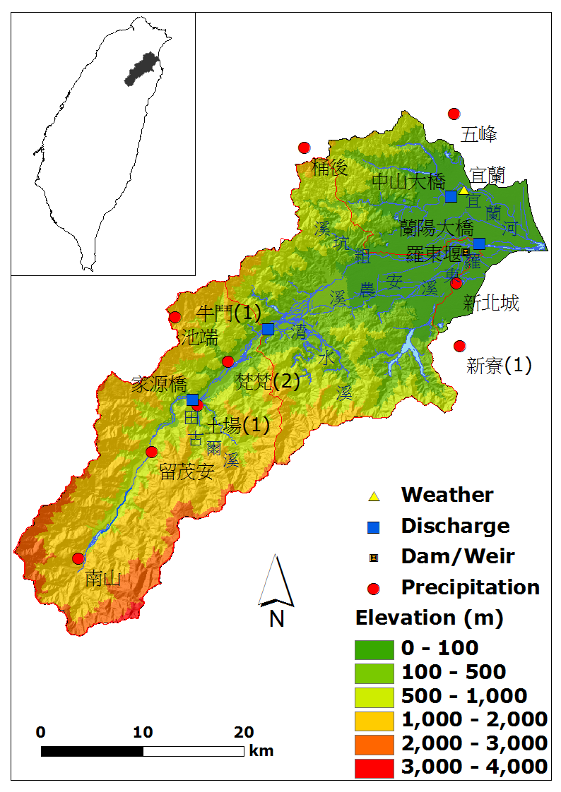
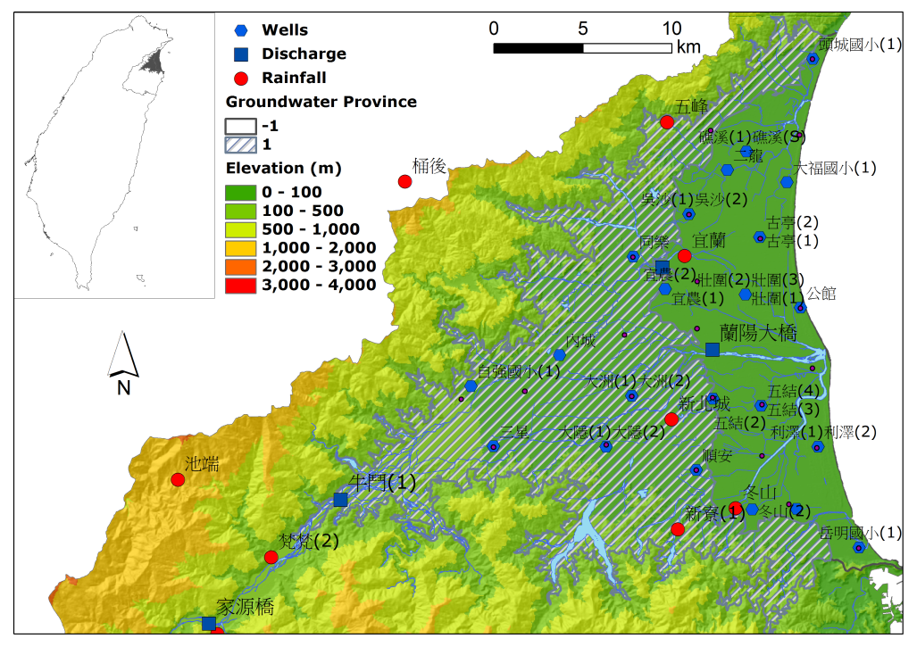
Visualization (cont.)
Watershed Map
Ground Water Province Map

Slide 21
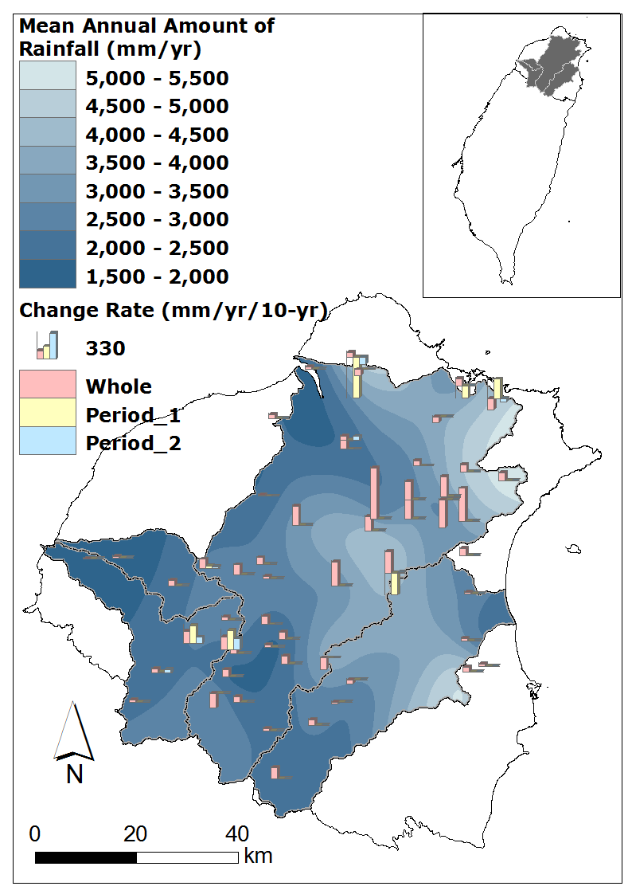
Visualization (cont.)

Slide 22
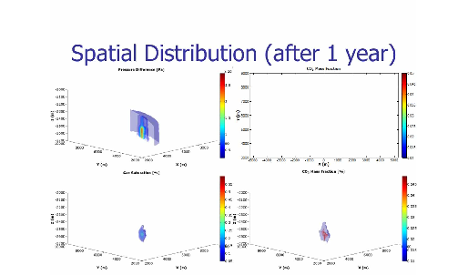
Spatial Topic: Animation
Animation is the rapid display of a sequence of images to create an illusion of movement.
We can produce the animation using MS PowerPoint or MATLAB etc.
Powered by Free Video to Flash Converter

Slide 23


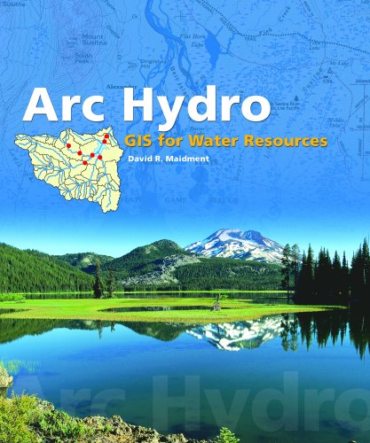
Reference:
Beven, Keith J., 2001, Rainfall-Runoff Modelling: The Primer, Wiley.
Sens, Kiven, 2009, Hydrometeorology—Forecasting and Applications, Springer.
Maidment, David R., 2002, Arc Hydro GIS for Water Resources, ESRI Press.

Slide 24
Questions or Comments?

